Slide 1

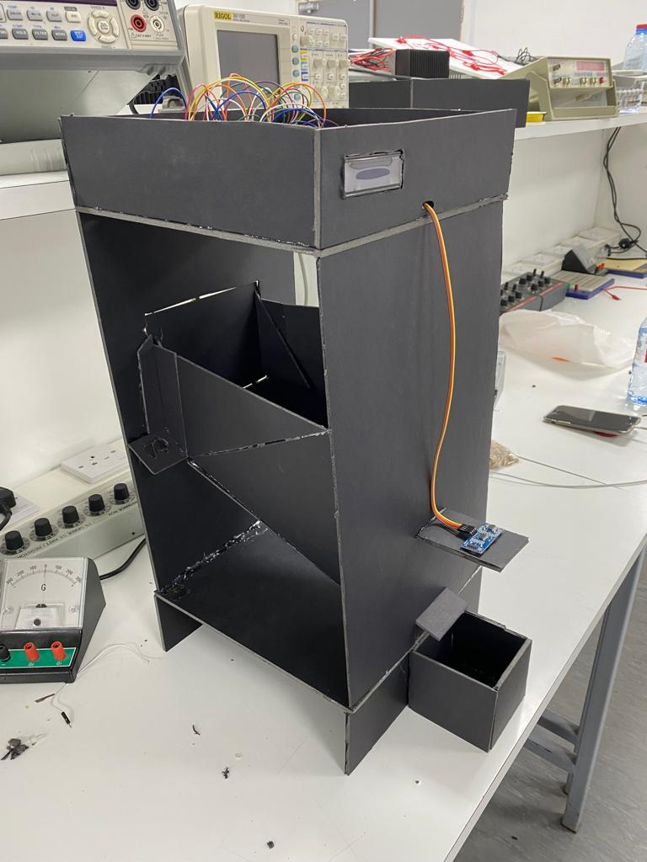
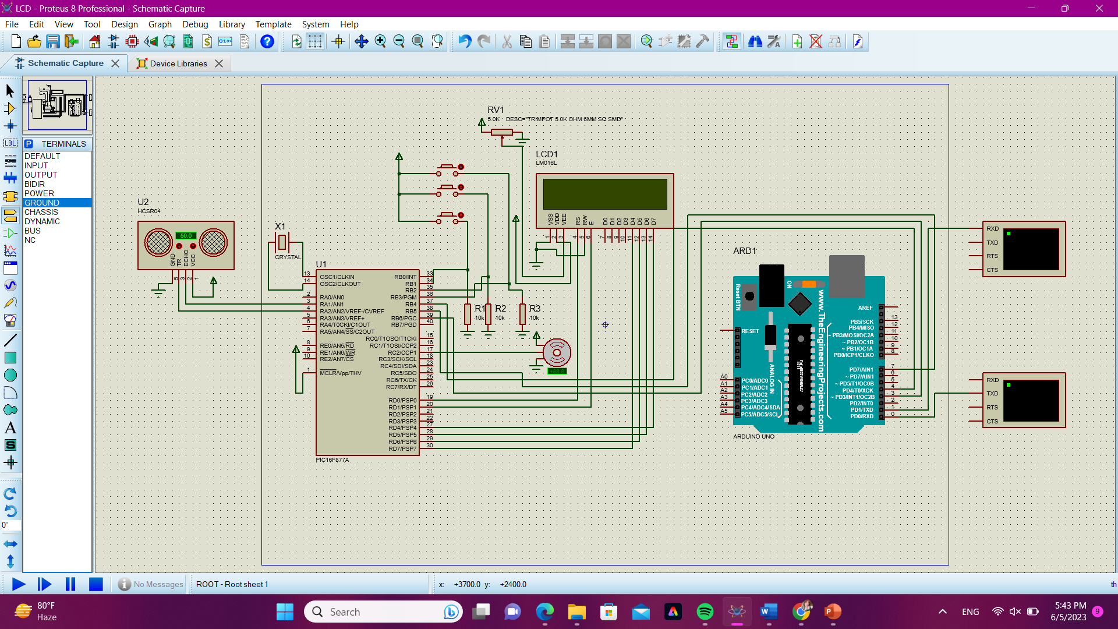
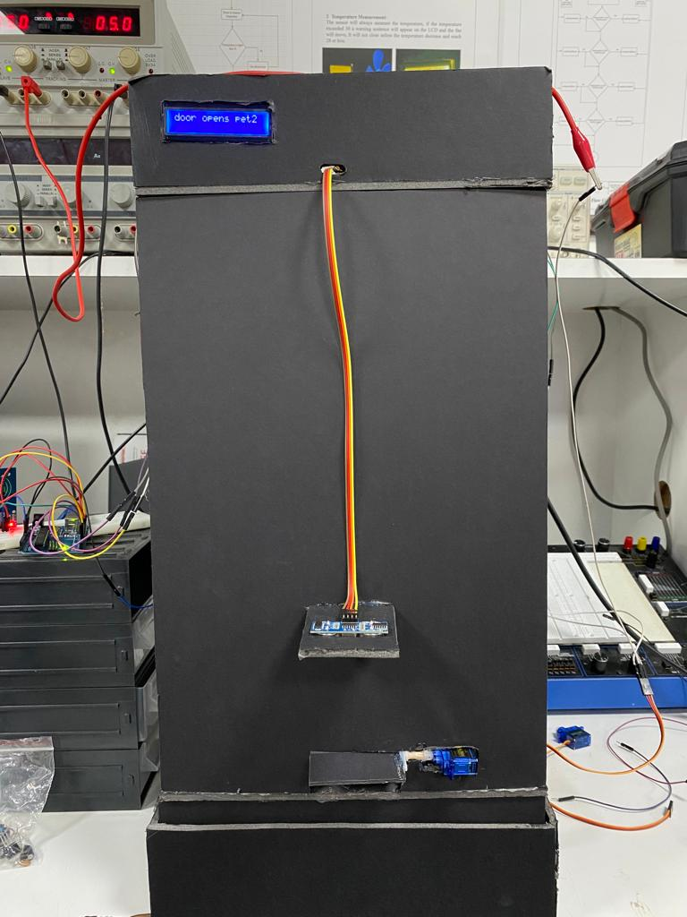
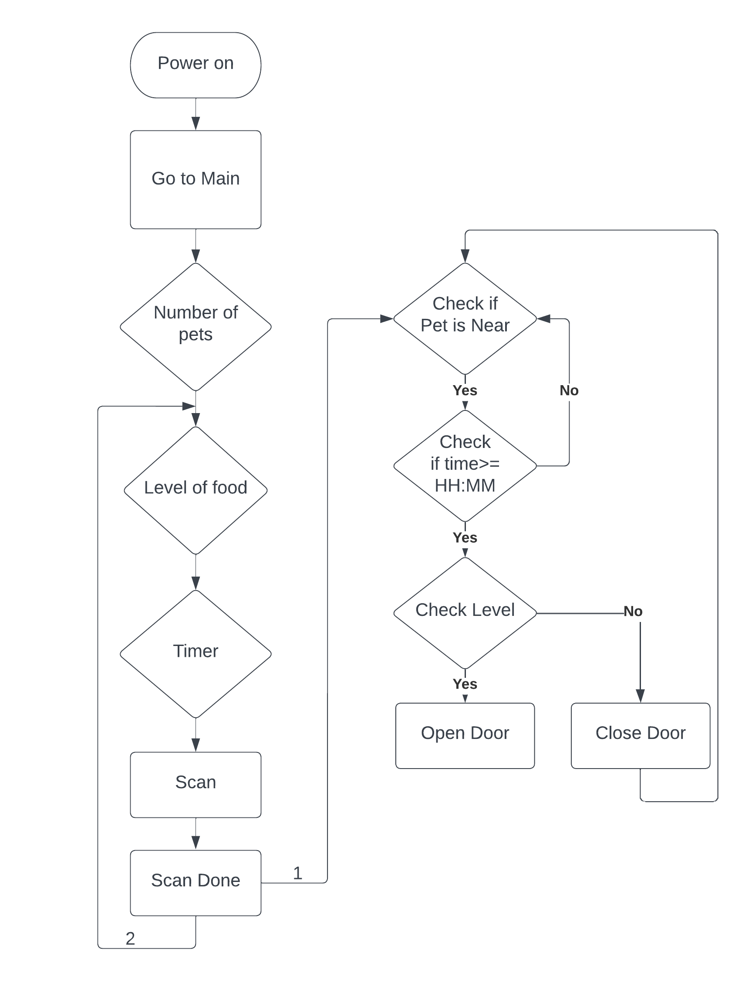
Pet Feeder Machine
A. Abusaada, M. Aljaouni and Z. AL-khalidi
Supervisor: Dr. Belal Sababha
Embedded Systems Final Design Project, Spring 2023
King Abdullah II School of Engineering
Princess Sumaya University for Technology
Introduction
An automated device known as a pet feeder machine; feeds animals either on a predetermined schedule or in reaction to a trigger, such as a particular sound or activity. It is intended to make feeding pets more convenient for pet owners, particularly for those who lead hectic lives or who spend a lot of time away from home.
Our pet feeding machine operates by enabling users to set food levels and feeding times for their pets. It utilizes a servo-controlled feeding door and an ultrasonic sensor to ensure that the desired food level is reached before closing the door. The device's functionality is based on user inputs and continuous monitoring of time for accurate feeding schedules.
Results
When a pet approaches the machine, its tag is scanned for identification, and various conditions are checked, if all conditions are met; such as the feeding time and the input food level being appropriate, the servo-controlled door opens, allowing the food to be dispensed. This ensures that the pet receives the right amount of food based on its individual needs.
Design
Figure 3
Figure 1: Electrical Design
Figure 2: Software Design
Figure 4
Conclusion
In conclusion, our pet feeding machine provides an efficient and practical solution for pet owners who cannot always be present since it automates the feeding by allowing users to set individualized feeding times and food levels for each pet, this device ensures that pets receive the appropriate amount of food at the designated times.
Overall, the pet feeding device project represents a successful integration of hardware and software components to create an automated solution for pet feeding. It demonstrates the potential for technology to enhance the lives of both pets and their owners by providing convenience, accuracy, and peace of mind. With further development and refinement, this project has the potential to become a valuable tool for pet owners worldwide.
.
.

